Slide 1

Netflix in Numbers
A Comprehensive Look at the Content Library and Platform Trends
SIC – AI801

Slide 2
Agenda
Team Members
Problem Statement and Data
EDA
Predashboard (Power Query)
Dashboard 1
Dashboard 2
Conclusion
Samsung Innovation Campus

Slide 3




Team Members
Yossef Haytham
Hamdy Osama
Asser Hanafy
Rahma Hosam
Samsung Innovation Campus

Slide 4
Problem Statement & Data
Samsung Innovation Campus

Slide 5
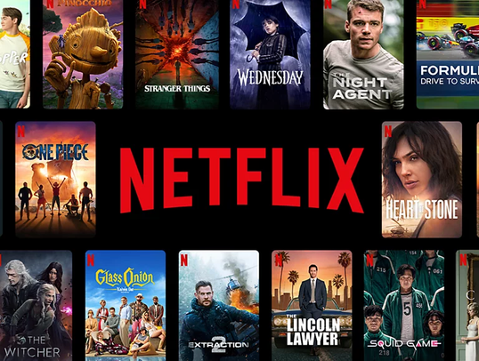
Problem Statement
▶ Netflix needs to understand exactly what kind of content they
have, where it comes from, and who it is meant for. The main
challenge is figuring out what types of movies, TV shows,
genres, and age ratings are the most popular so they can make
better choices about what to add to their library, both globally
and in specific countries like Egypt.
Samsung Innovation Campus

Slide 6


Main Questions
▶ Movies vs. TV Shows: Does Netflix have more movies or TV shows, and how much has the total number of titles grown between between the years?
▶ Top Countries: Which countries make the most content for Netflix?
▶ Target Audience: What age groups (like TV-MA or TV-14) get the most content? Do these age groups get more movies or more TV shows?
Samsung Innovation Campus

Slide 7


Main Questions
▶ Average Lengths: On average, how many minutes long are the movies, and how many seasons do the TV shows usually have?
▶ Country Spotlight (Egypt): What does the Netflix library look like in Egypt? For example, do they have a stronger focus on movies over TV shows, and what are the top five genres there?
Samsung Innovation Campus

Slide 8
EDA
Samsung Innovation Campus

Slide 9
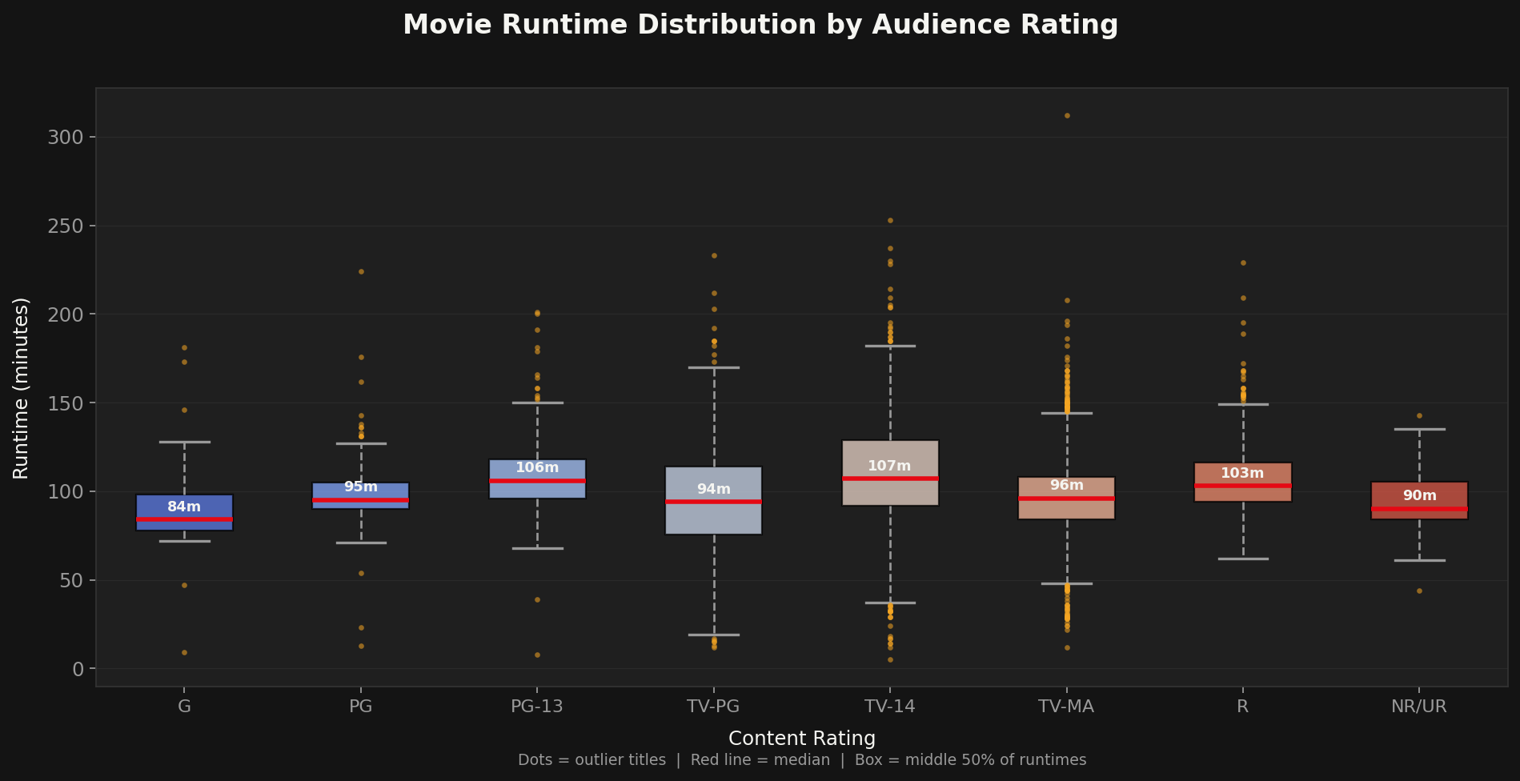
Movie Runtime by Rating Boxplot
Samsung Innovation Campus

Slide 10
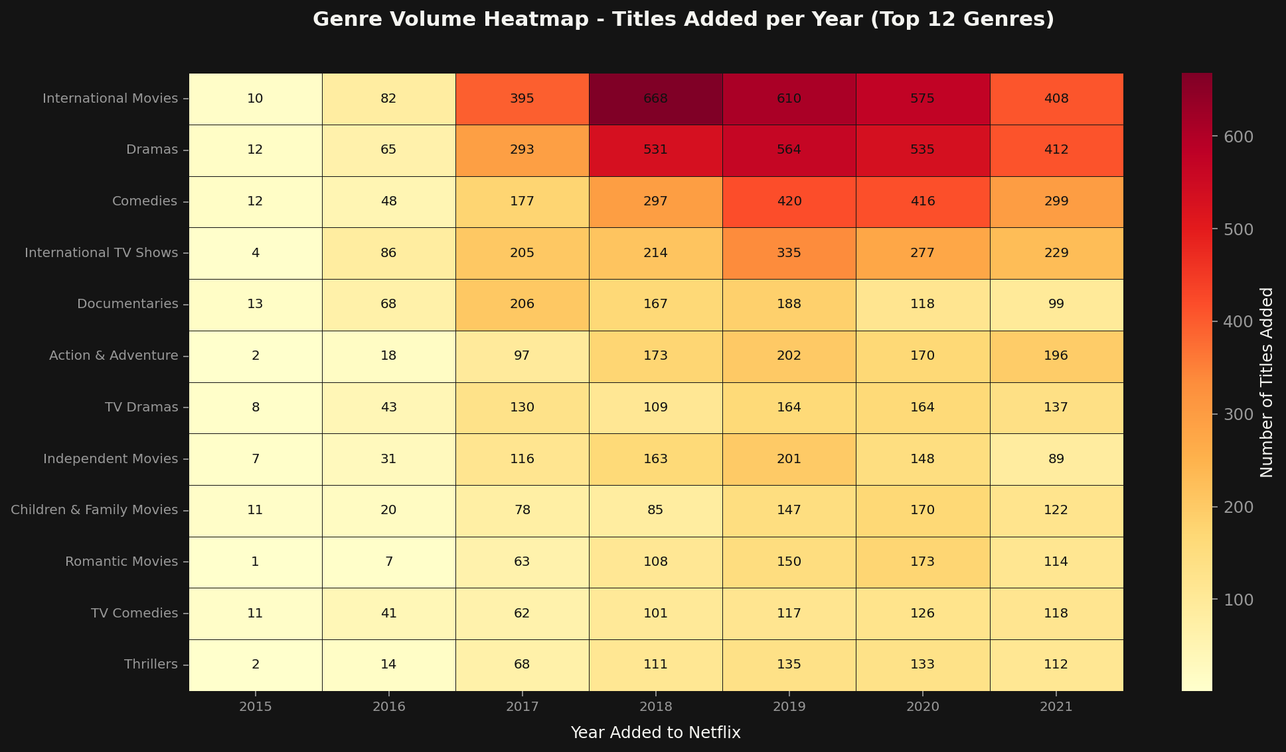
Genre Heatmap by Year
Samsung Innovation Campus

Slide 11
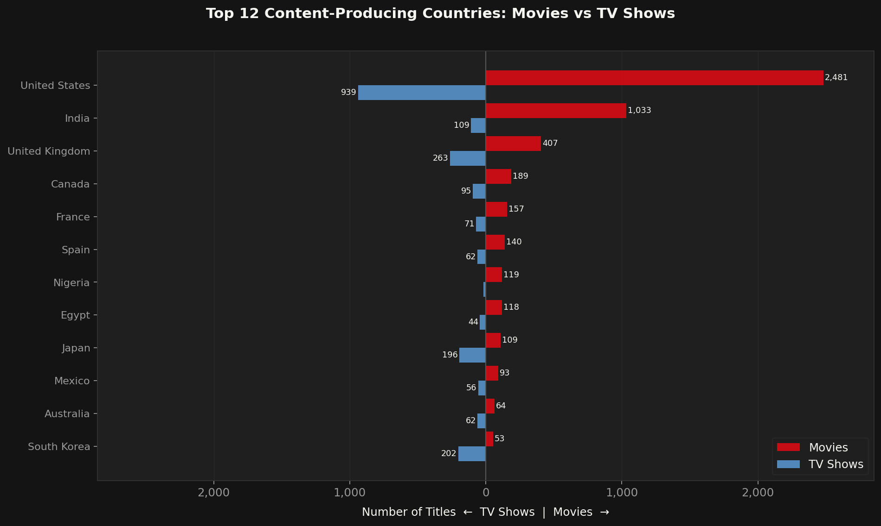
Country Diverging Bar
Samsung Innovation Campus

Slide 12
Predashboard (Power Query)
Samsung Innovation Campus

Slide 13
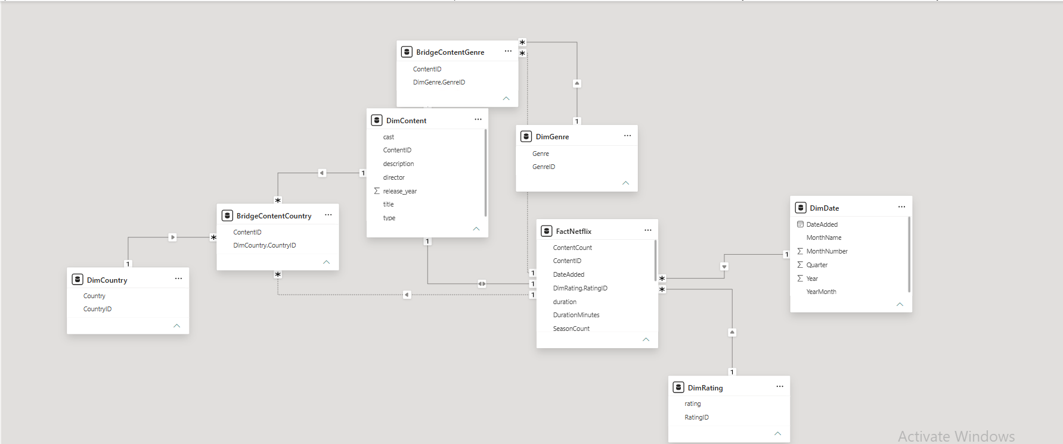
Netflix Data Model – Star Schema Relationships
Samsung Innovation Campus

Slide 14
Dashboard
Dual-page dashboard
Platform Overview and Strategic Insights
NETFLIX CONTENT
OVERVIEW
NETFLIX CONTENT
STRATEGY
Samsung Innovation Campus

Slide 15

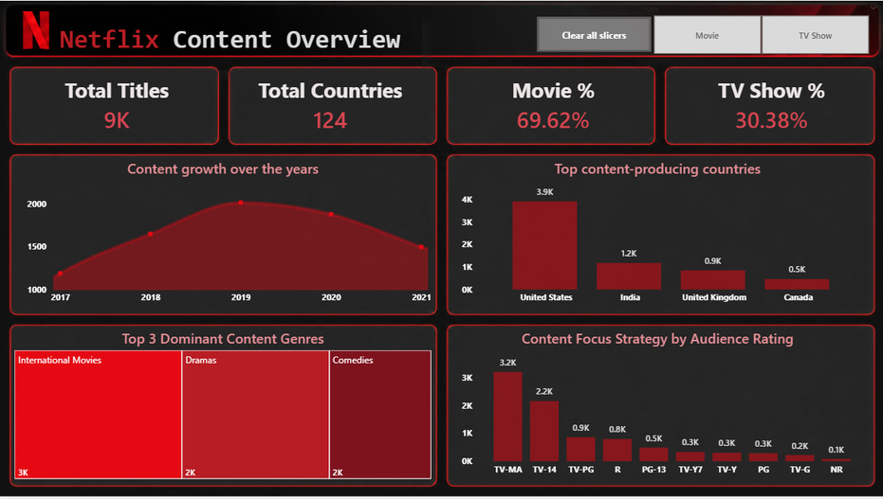
Quick Look on Netflix Content Overview
Page One
Samsung Innovation Campus

Slide 16
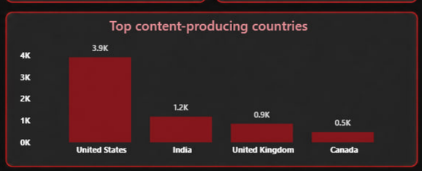
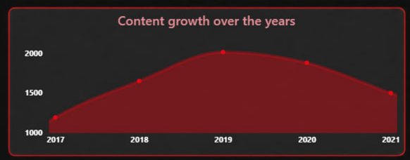
Some Key Findings from the Data
WHERE AND WHEN DID NETFLIX’S PRODUCTION EXPLODE
THE CHARTS SHOW A CLEAR ESCALATION IN CONTENT PUBLISHING, WITH THE UNITED STATES HOLDING THE FIRST PLACE IN GLOBAL PRODUCTION
Samsung Innovation Campus

Slide 17
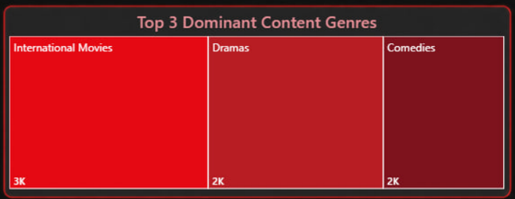
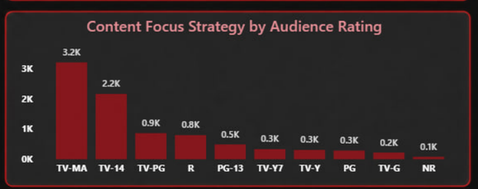
Some Key Findings from the Data
WHAT IS THE MOST COMMON CONTENT, AND WHO IS THE MAIN TARGET AUDIENCE?
THE CHARTS HIGHLIGHT INTERNATIONAL MOVIES AND DRAMAS AS THE MOST COMMON CONTENT, WITH THE MAJORITY OF PRODUCTION TARGETING MATURE AUDIENCES (TV-MA)
Samsung Innovation Campus

Slide 18
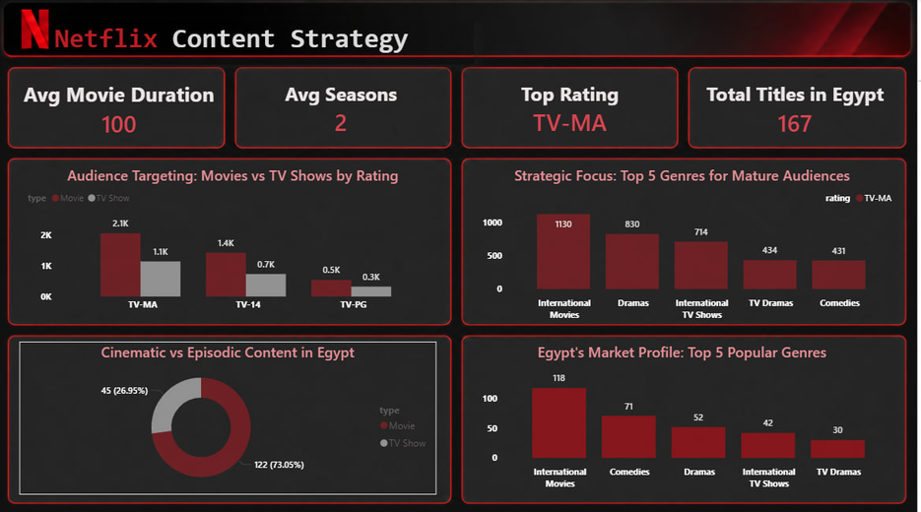
Quick Look on Netflix Content Stratagy
Page Two
Samsung Innovation Campus

Slide 19
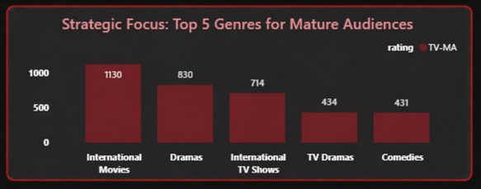
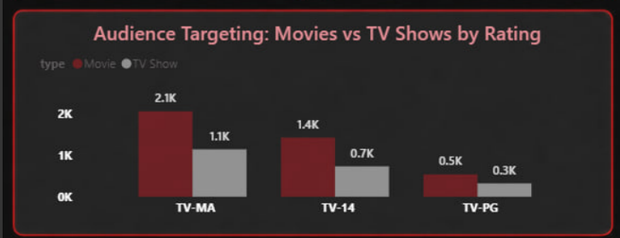
Some Key Findings from the Data
WHO IS THE MAIN TARGET AUDIENCE, AND WHICH GENRES DOMINATE THE STRATEGY?
THE CHARTS HIGHLIGHT A STRATEGIC FOCUS ON MATURE AUDIENCES (TV-MA), PRIMARILY DRIVEN BY INTERNATIONAL MOVIES AND DRAMAS
Samsung Innovation Campus

Slide 20
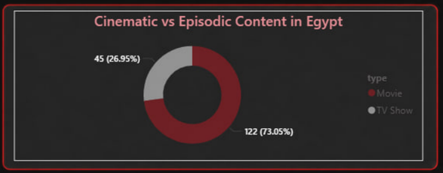
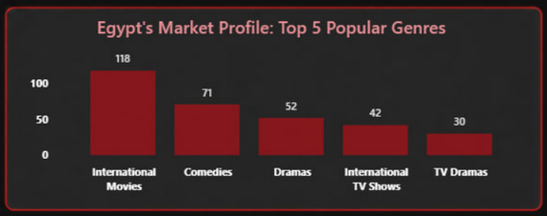
Some Key Findings from the Data
WHAT DEFINES NETFLIX'S STRATEGY IN EGYPT, AND WHICH GENRES ARE MOST POPULAR?
THE CHARTS SHOW THAT THE EGYPTIAN MARKET IS DOMINATED BY CINEMATIC CONTENT, WITH A HIGH DEMAND FOR INTERNATIONAL MOVIES AND COMEDIES
Samsung Innovation Campus

Slide 21
Conclusion
THIS ANALYSIS MAPS NETFLIX’S CONTENT STRATEGY UP TO 2021, SERVING AS A CLEAR HISTORICAL BASELINE TO MEASURE THE PLATFORM'S FUTURE EVOLUTION AND STRATEGIC DECISIONS.
Samsung Innovation Campus

Slide 22

ⓒ2020 SAMSUNG. All rights reserved.
Samsung Electronics Corporate Citizenship Office holds the copyright of book.
This book is a literary property protected by copyright law so reprint and reproduction without permission are prohibited.
To use this book other than the curriculum of Samsung innovation Campus or to use the entire or part of this book, you must receive written consent from copyright holder.

